Slide 1
Chapter 2: Java Beans & Multi-Threading

Slide 2
Learning Objectives
Bean Properties
Bean Methods
Bean Events
Using BeanInfo class
Bean Persistence (Long and Short - Serializable interface, XmlEncoder class)
Instrospection Mechanism
Reflection
java.lang.Class
java.lang.reflect.Field
java.lang.reflect.Method
java.lang.reflect.Constructor
java.lang.reflect.Modifier
Introduction to Threads and Concurrency
Defining, Instantiating, and Starting threads by
"Extending Thread class implementing Runnable interface"
Main thread
Thread Priorities
Thread names
Sleep(), Join()
Daemon threads
Synchronization
Interthread communication

Slide 3
Java Bean
A Java Bean is a java class that should follow following conventions:
It should have a no-arg constructor.
It should be Serializable.
It should provide methods to set and get the values of the properties, known as getter and setter methods.
it is a reusable software component. A bean encapsulates many objects into one object, so we can access this object from multiple places. Moreover, it provides the easy maintenance.

Slide 4
Java Bean - Properties
Bean properties are attributes of the bean's internal state. These associated pieces can be:
queried or
can be set via appropriate methods exported by the bean.
In addition to basic properties, the property itself may be indexed, bound or constrained.

Slide 5
Properties
An indexed property has an array value whereas methods allow each element or the entire array to be set.
A bound property provides notification service when a property changes. In general, a PropertyChangeListener event listener interface reports the event.
A constrained property not only notifies registered listeners, but it also allows for input. Another bean may veto the change deeming it invalid; thus the property change cannot commence until all interested beans concur.

Slide 6
Methods
JavaBean methods do not entail any special meaning. They are simply any external methods supported by a bean.
A bean's methods are the things it can do. Any public method that is not part of a property definition is a bean method. When you use a bean in the context of a builder tool like NetBeans, you can use a bean's methods as part of your application. For example, you could wire a button press to call one of your bean's methods.

Slide 7
Events
Events are a core feature of the JavaBeans. This is well suited for event driven programming. JavaBean event modelling is based on the AWT components.
When an event is dispatched to the appropriate listener, it passes through the processEvent() method. In general, this method checks the class of the event and sends it to the class specific method. For example, if a mouse event occurred, the event is passed to either:
processMouseEvent() or
processMouseMotionEvent().

Slide 8
Events Model

Slide 9
Events - How it works
A bean class can fire off any type of event, including custom events. As with properties, events are identified by a specific pattern of method names.
public void add<Event>Listener(<Event>Listener a)
public void remove<Event>Listener(<Event>Listener a)
The listener type must be a descendant of java.util.EventListener.
For example, a Swing JButton is a bean that fires action events when the user clicks on it. JButton includes the following methods (actually inherited from AbstractButton), which are the bean pattern for an event:
public void addActionListener(ActionListener l);
public void removeActionListener(ActionListener l);
Bean events are recognised by builder tools and can be used in wiring components together. For example, you can wire a button's action event to make \something happen, like invoking another bean's method.

Slide 10
Java.beans Package
The java.beans package contains classes and interfaces related to JavaBeans components. Most of the classes and interfaces are used by tools that manipulate beans, rather than by the beans themselves. They are also used or implemented by auxiliary classes provided by bean implementors for the benefit of bean-manipulation tools.
The Beans class defines several generally useful static methods. Its instantiate() method is particularly important. The Introspector class is used to obtain information about a bean and the properties, events, and methods it exports. Most of this information is returned using the FeatureDescriptor class and its various subclasses. The java.beans package also defines the PropertyChangeEvent class and the PropertyChangeListener interface that are widely used by AWT and Swing to provide notification when a bound property of a GUI component changes.

Slide 11
Java.beans Package - Hierarchy

Slide 12
Java.beans.Introspector Class
The Introspector is a class that is never instantiated. Its static getBeanInfo() methods provide a way to obtain information about a JavaBeans component and are typically only invoked by application builders or similar tools. getBeanInfo() first looks for a BeanInfo class for the specified bean class. For a class named x, it looks for a BeanInfo class named xBeanInfo, first in the current package and then in each of the packages in the BeanInfo search path.
If no BeanInfo class is found, or if the BeanInfo class found does not provide complete information about the bean properties, events, and methods, getBeanInfo() introspects on the bean class by using the java.lang.reflect package to fill in the missing information. When explicit information is provided by a BeanInfo class, getBeanInfo() treats it as definitive. When determining information through introspection, however, it examines each of the bean's superclasses in turn, looking for a BeanInfo class at that level or using introspection. When callinggetBeanInfo(), you may optionally specify a second class argument that specifies a superclass for which, and above which, getBeanInfo() does not introspect.

Slide 13
Purpose of Introspection
A growing number of Java object repository sites exist on the Internet in answer to the demand for centralized deployment of applets, classes, and source code in general. Any developer who has spent time hunting through these sites for licensable Java code to incorporate into a program has undoubtedly struggled with issues of how to quickly and cleanly integrate code from one particular source into an application.
The way in which introspection is implemented provides great advantages, including:
Portability - Everything is done in the Java platform, so you can write components once, reuse them everywhere. There are no extra specification files that need to be maintained independently from your component code. There are no platform-specific issues to contend with. Your component is not tied to one component model or one proprietary platform. You get all the advantages of the evolving Java APIs, while maintaining the portability of your components.
Reuse - By following the JavaBeans design conventions, implementing the appropriate interfaces, and extending the appropriate classes, you provide your component with reuse potential that possibly exceeds your expectations.

Slide 14
Introspector - Hierarchy

Slide 15
Examples: Chapter 2
See COREJ2-Chapter2 at https://github.com/CompleteJavaTraining/JavaEssentials/tree/master/Code/COREJ2-Chapter2

Slide 16
What is Reflection
Reflection is a process of examining or modifying the run time behavior of a class at run time.
The java.lang.Class class provides many methods that can be used to get metadata, examine and change the run time behavior of a class.
The java.lang and java.lang.reflect packages provide classes for java reflection.

Slide 17
java.lang.Class class
The java.lang.Class class performs mainly two tasks:
provides methods to get the metadata of a class at run time.
provides methods to examine and change the run time behavior of a class.

Slide 18
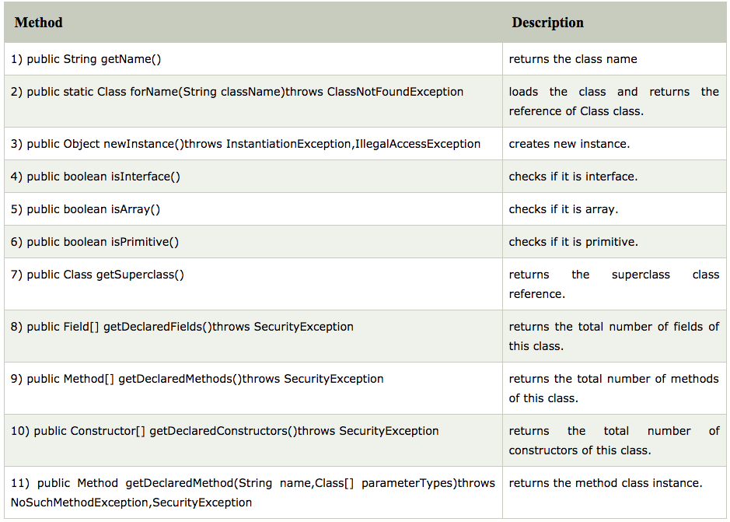
Commonly used methods of Class class:

Slide 19
How to get the object of Class class?
There are 3 ways to get the instance of Class class. They are as follows:
forName() method of Class class
getClass() method of Object class (available on all types by default in Java)
the .class syntax (calling the static method on all types available by default in Java)

Slide 20
Determining the class object
Following methods of Class class is used to determine the class object:
public boolean isInterface(): determines if the specified Class object represents an interface type.
public boolean isArray(): determines if this Class object represents an array class.
public boolean isPrimitive(): determines if the specified Class object represents a primitive type.
Let's see the simple example of reflection api to determine the object type.

Slide 21
More on Reflection - Field
Defined in package java.lang.reflect
Encapsulates the field of a class.
2 methods on an instance of java.lang.Class class return fields defined on a type:
getFields(): returns an array containing Field objects reflecting all the accessible public members of the class or interface represented by this Class object.
getDeclaredFields(): returns array of Field objects reflecting all the fields declared by the class or interface represented by this Class object.
Field object exposes an API that allows you to dynamically set values of fields on a given instance

Slide 22
More on Reflection - Method
Defined in package java.lang.reflect
Encapsulates the method of a class.
2 methods on an instance of java.lang.Class class return methods defined on a type:
getMethods(): method returns array of Method object that reflect all the public method of invoking object.
getDeclaredMethods(): returns only the declared methods of the invoking class object.
Method object exposes an API that allows you to dynamically call methods on a given instance

Slide 23
More on Reflection - Constructor
The pattern for Constructor is similar to Method. Remember constructor is also nothing but a special method.

Slide 24
More on Reflection - Modifier
There are several modifiers that may be part of a field declaration:
Access modifiers: public, protected, and private
Field-specific modifiers governing runtime behaviour: transient and volatile
Modifier restricting to one instance: static
Modifier prohibiting value modification: final
Annotations

Slide 25
Examples: Chapter 2
See COREJ2-Chapter2 at https://github.com/CompleteJavaTraining/JavaEssentials/tree/master/Code/COREJ2-Chapter2

Slide 26
What is Multithreading?
Multithreading is similar to multi-processing.
A multi-processing Operating System can run several processes at the same time.
Each process has its own address/memory space
The OS's scheduler decides when each process is executed.
Only one process is actually executing at any given time. However, the system appears to be running several programs simultaneously.
Separate processes to not have access to each other's memory space.
Many OSes have a shared memory system so that processes can share memory space.
In a multithreaded application, there are several points of execution within the same memory space.
Each point of execution is called a thread.
Threads share access to memory.

Slide 27
Why use Multithreading?
In a single threaded application, one thread of execution must do everything
If an application has several tasks to perform, those tasks will be performed when the thread can get to them.
A single task which requires a lot of processing can make the entire application appear to be "sluggish" or unresponsive.
In a multithreaded application, each task can be performed by a separate thread
If one thread is executing a long process, it does not make the entire application wait for it to finish.
If a multithreaded application is being executed on a system that has multiple processors, the OS may execute separate threads simultaneously on separate processors.

Slide 28
What Kind of Applications Use Multithreading?
Any kind of application which has distinct tasks which can be performed independently
Any application with a GUI.
Threads dedicated to the GUI can delegate the processing of user requests to other threads.
The GUI remains responsive to the user even when the user's requests are being processed
Any application which requires asynchronous response
Network based applications are ideally suited to multithreading.
Data can arrive from the network at any time.
In a single threaded system, data is queued until the thread can read the data
In a multithreaded system, a thread can be dedicated to listening for data on the network port
When data arrives, the thread reads it immediately and processes it or delegates its processing to another thread

Slide 29
Methods
JavaBean methods do not entail any special meaning. They are simply any external methods supported by a bean.
A bean's methods are the things it can do. Any public method that is not part of a property definition is a bean method. When you use a bean in the context of a builder tool like NetBeans, you can use a bean's methods as part of your application. For example, you could wire a button press to call one of your bean's methods.

Slide 30
How does it all work?
Each thread is given its own “context".
A thread's context includes virtual registers and its own calling stack.
The "scheduler" decides which thread executes at any given time
The VM may use its own scheduler.
Since many OSes now directly support multithreading, the VM may use the system's scheduler for scheduling threads.
The scheduler maintains a list of ready threads (the run queue) and a list of threads waiting for input (the wait queue).
Each thread has a priority. The scheduler typically schedules between the highest priority threads in the run queue.
Note: the programmer cannot make assumptions about how threads are going to be scheduled. Typically, threads will be executed differently on different platforms.

Slide 31
Thread Support in Java
Few programming languages directly support threading.
Although many have add-on thread support.
Add on thread support is often quite cumbersome to use.
The Java Virtual machine has its own runtime threads.
Used for garbage collection.
Threads are represented by a Thread class.
A thread object maintains the state of the thread.
It provides control methods such as interrupt, start, sleep, yield, wait.
When an application executes, the main method is executed by a single thread.
If the application requires more threads, the application must create them.

Slide 32
Thread States
Threads can be in one of four states:
Created, Running, Blocked, and Dead
A thread's state changes based on:
Control methods such as start, sleep, yield, wait, notify
Termination of the run method

Slide 33
Thread States
sleep
done sleeping
blocked
suspend
new
resume
start
await
signal
runnable
Wait for lock
Lock available
block on I/O
run exits stop
I/O complete
dead

Slide 34
How does a Thread run?
The thread class has a run() method.
run() is executed when the thread's start() method is invoked.
The thread terminates if the run method terminates.
To prevent a thread from terminating, the run method must not end.
run methods often have an endless loop to prevent thread termination.
One thread starts another by calling its start method.
The sequence of events can be confusing to those more familiar with a single threaded model.
Thread1
start()
Thread2
Thread Object
run()

Slide 35
Creating your own Threads
The obvious way to create your own threads is to subclass the Thread class and then override the run() method.
This is the easiest way to do it
It is not the recommended way to do it.
Because threads are usually associated with a task, the object which provides the run method is usually a subclass of some other class
If it inherits from another class, it cannot inherit from Thread.
The solution is provided by an interface called Runnable.
Runnable defines one method - public void run()
One of the Thread classes constructor takes a reference to a Runnable object
When the thread is started, it invokes the run method in the runnable object instead of its own run method.

Slide 36
Using Runnable
In the example below, when the Thread object is instantiated, it is passed a reference to a "Runnable" object
The Runnable object must implement a method called "run"
When the thread object receives a start message, it checks to see if it has a reference to a Runnable object:
If it does, it runs the "run" method of that object
If not, it runs its own "run" method
Thread1
start()
Thread2
Thread Object
Runnable Object
run()
run()

Slide 37
Properly Terminating Threads
In Java 1.1, the Thread class had a stop() method
One thread could terminate another by invoking its stop() method.
However, using stop() could lead to deadlocks
The stop() method is now deprecated. DO NOT use the stop method to terminate a thread
The correct way to stop a thread is to have the run method terminate
Add a boolean variable which indicates whether the thread should continue or not
Provide a set method for that variable which can be invoked by another thread.

Slide 38
Properly Terminating Threads
Every thread is assigned a priority (between 1 and 10)
The default is 5
The higher the number, the higher the priority
Can be set with setPriority(int aPriority)
The standard mode of operation is that the scheduler executes threads with higher priorities first.
This simple scheduling algorithm can cause problems. Specifically, one high priority thread can become a "CPU hog".
A thread using vast amounts of CPU can share CPU time with other threads by invoking the yield() method on itself.
Most OSes do not employ a scheduling algorithm as simple as this one
Most modern OSes have thread aging
The more CPU a thread receives, the lower its priority becomes
The more a thread waits for the CPU, the higher its priority becomes
Because of thread aging, the effect of setting a thread's priority is dependent on the platform

Slide 39
The join() method
The join() method waits for a thread to die.
In other words, it causes the currently running threads to stop executing until the thread it joins with completes its task.

Slide 40
Naming a thread
The Thread class provides methods to change and get the name of a thread. By default, each thread has a name i.e. thread-0, thread-1 and so on. By we can change the name of the thread by using setName() method. The syntax of setName() and getName() methods are given below:
public String getName(): is used to return the name of a thread.
public void setName(String name): is used to change the name of a thread.
The currentThread() method returns a reference of currently executing thread.

Slide 41
Daemon Threads
Daemon thread in java is a service provider thread that provides services to the user thread. Its life depend on the mercy of user threads i.e. when all the user threads dies, JVM terminates this thread automatically.
There are many java daemon threads running automatically e.g. gc, finalizer etc.
It provides services to user threads for background supporting tasks. It has no role in life than to serve user threads.
Its life depends on user threads.
It is a low priority thread.
The sole purpose of the daemon thread is that it provides services to user thread for background supporting task. If there is no user thread, why should JVM keep running this thread. That is why JVM terminates the daemon thread if there is no user thread.

Slide 42
Managing Scheduling - yield() and sleep()
Sometimes a thread can determine that it has nothing to do
Sometimes the system can determine this. ie. waiting for I/O
When a thread has nothing to do, it should not use CPU
This is called a busy-wait.
Threads in busy-wait are busy using up the CPU doing nothing.
Often, threads in busy-wait are continually checking a flag to see if there is anything to do.
It is worthwhile to run a CPU monitor program on your desktop
You can see that a thread is in busy-wait when the CPU monitor goes up (usually to 100%), but the application doesn't seem to be doing anything.
Threads in busy-wait should be moved from the Run queue to the Wait queue so that they do not hog the CPU
Use yield() or sleep(time)
Yield simply tells the scheduler to schedule another thread
Sleep guarantees that this thread will remain in the wait queue for the specified number of milliseconds.

Slide 43
Concurrent Access to Data
Those familiar with databases will understand that concurrent access to data can lead to data integrity problems
Specifically, if two sources attempt to update the same data at the same time, the result of the data can be undefined.
The outcome is determined by how the scheduler schedules the two sources.
Since the schedulers activities cannot be predicted, the outcome cannot be predicted
Databases deal with this mechanism through "locking"
If a source is going to update a table or record, it can lock the table or record until such time that the data has been successfully updated.
While locked, all access is blocked except to the source which holds the lock.
Java has the equivalent mechanism. It is called synchronization
Java has a keyword called synchronized

Slide 44
Synchronization
In Java, every object has a lock
To obtain the lock, you must synchronize with the object
The simplest way to use synchronization is by declaring one or more methods to be synchronized
When a synchronized method is invoked, the calling thread attempts to obtain the lock on the object.
if it cannot obtain the lock, the thread goes to sleep until the lock becomes available
Once the lock is obtained, no other thread can obtain the lock until it is released. ie, the synchronized method terminates
When a thread is within a synchronized method, it knows that no other synchronized method can be invoked by any other thread
Therefore, it is within synchronized methods that critical data is updated

Slide 45
Inter-thread communication
Inter-thread communication or Co-operation is all about allowing synchronized threads to communicate with each other.
Cooperation (Inter-thread communication) is a mechanism in which a thread is paused running in its critical section and another thread is allowed to enter (or lock) in the same critical section to be executed.It is implemented by following methods of Object class:
wait()
notify()
notifyAll()

Slide 46
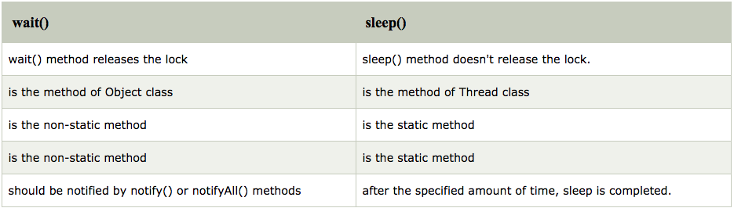
Difference between wait and sleep?

Slide 47
Examples: Chapter 2
See COREJ2-Chapter2 at https://github.com/CompleteJavaTraining/JavaEssentials/tree/master/Code/COREJ2-Chapter2

Slide 48
What are we learning in Next Chapter ?
You will learn about Streams Based I/O (input/output), Networking and Serialization
We will learn about:
Introduction to I/O and Streams
Introduction and Implementation of ByteStream
Character Streams
Buffered Streams
Data Streams and Object Streams
File I/O
Introduction to Network Programming
Introduction to TCP and UDP
Implementation of Socket and InetAddress class
URL in Terms of Java Network Programming
Datagram in network environment
DNS and Reverse DNS Lookup
Serializable in Java
Class Refactoring with Serialization and serialVersionUID
Java Externalizable Interface
Java Serialization Methods
Serialization with Inheritance
Serialization Proxy Pattern

Slide 49
Thank You !

